Slide 1
NYSGA GUIDEBOOK CHAPTERS AND INDEX NOW AVAILABLE
Otto H. Muller
Geology Department
Alfred University
fmuller@alfred.edu
David Valentino
Department of Atmospheric and Geological Sciences
SUNY at Oswego
Notes:
In this talk we describe our progress to date in putting the Guidebooks from the New York State Geological Association (NYSGA) field conferences into computer accessible format. We chose to produce kml files, easily used in Google Earth and other free or inexpensive applications, rather than ArcGIS files as our intention is to provide wide access to as many users as possible.

Slide 2
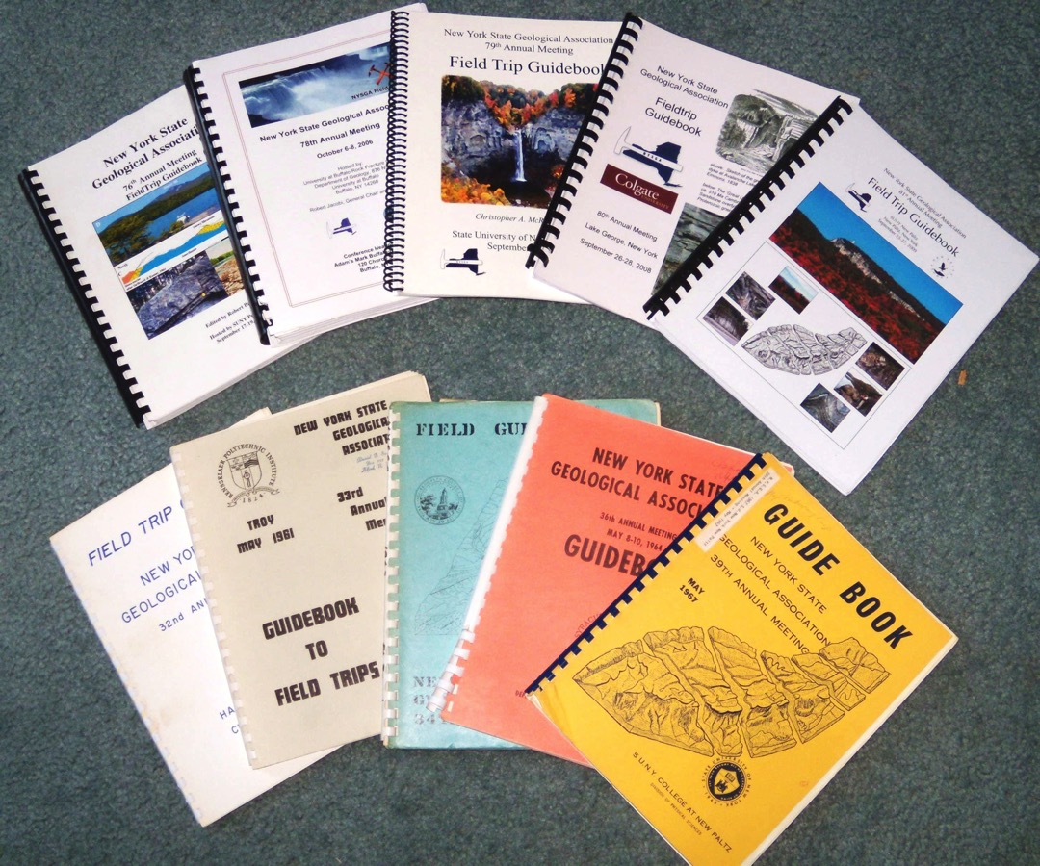
61 years of evolving thoughts
...about the same rocks
Notes:
The Guidebook on the lower right is from New Paltz, 1967, and the one directly above it is also from New Paltz, but 2009! The same rocks and outcrops, but interpretations are separated by 42 years... Most Geology Department libraries in NY have collections of these Guidebooks. And in the past I might spend a lot of time browsing through many of them to find an article which I remembered seeing. The work we report today is intended to remedy that!

Slide 3
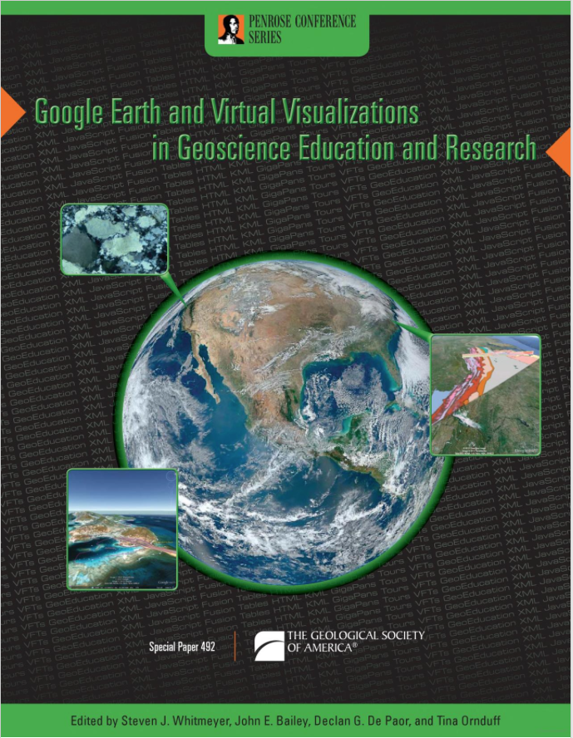
Complete instructions, useful for other Field Trip Guidebooks, can be found in GSA Special Paper 492:
Google Earth and Virtual Visualizations in Geoscience Education and Research
Whitmeyer, Bailey, DePaor and Ornduff, eds.
2012
Notes:
We have taken the Road Logs from the field trips and put them into kml files, locating each stop as accurately as we could on Google Earth. The techniques we used are described in detail in GSA Special Paper 492, Google Earth and Virtual Visualizations in Geoscience Education and Research, Whitmeyer, Bailey, DePaor and Ornduff, eds., 2012.

Slide 4
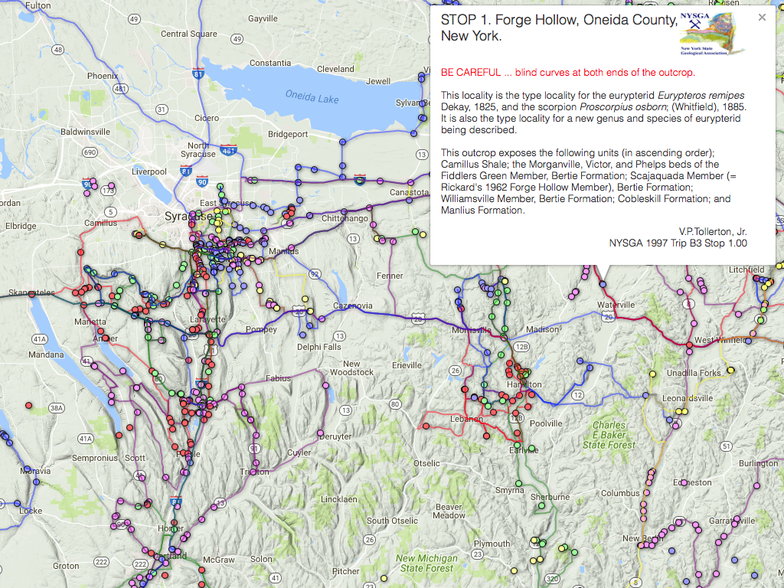
Notes:
Originally enamored by Google Fusion Tables, we hoped that former participants might contribute photos and data to these tables as a collaborative effort. So far there has been little of that. One big advantage of the Fusion Tables is that you can download the code to embed these maps into your own website. When you do so, the Placemarks are "live" and will open with a window such as this one.

Slide 5
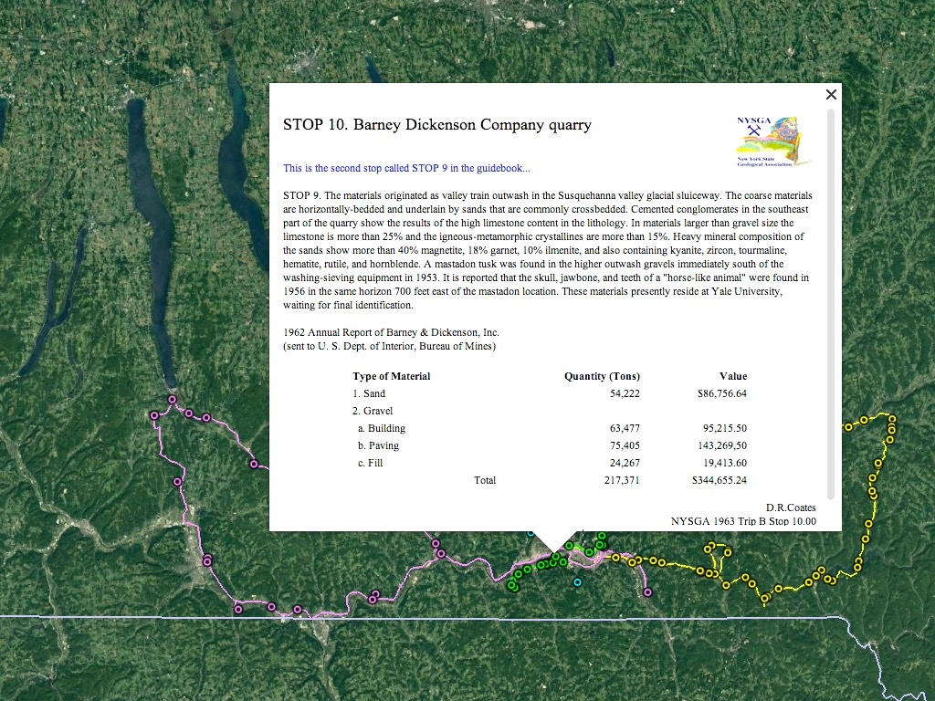
Notes:
The kml format is what Google Earth uses. Here we see the field trips from a 1963 meeting in Binghamton. As we worked on this it became apparent that the digital results from the road logs might go a long way toward developing a useful index to these Guidebooks.

Slide 6
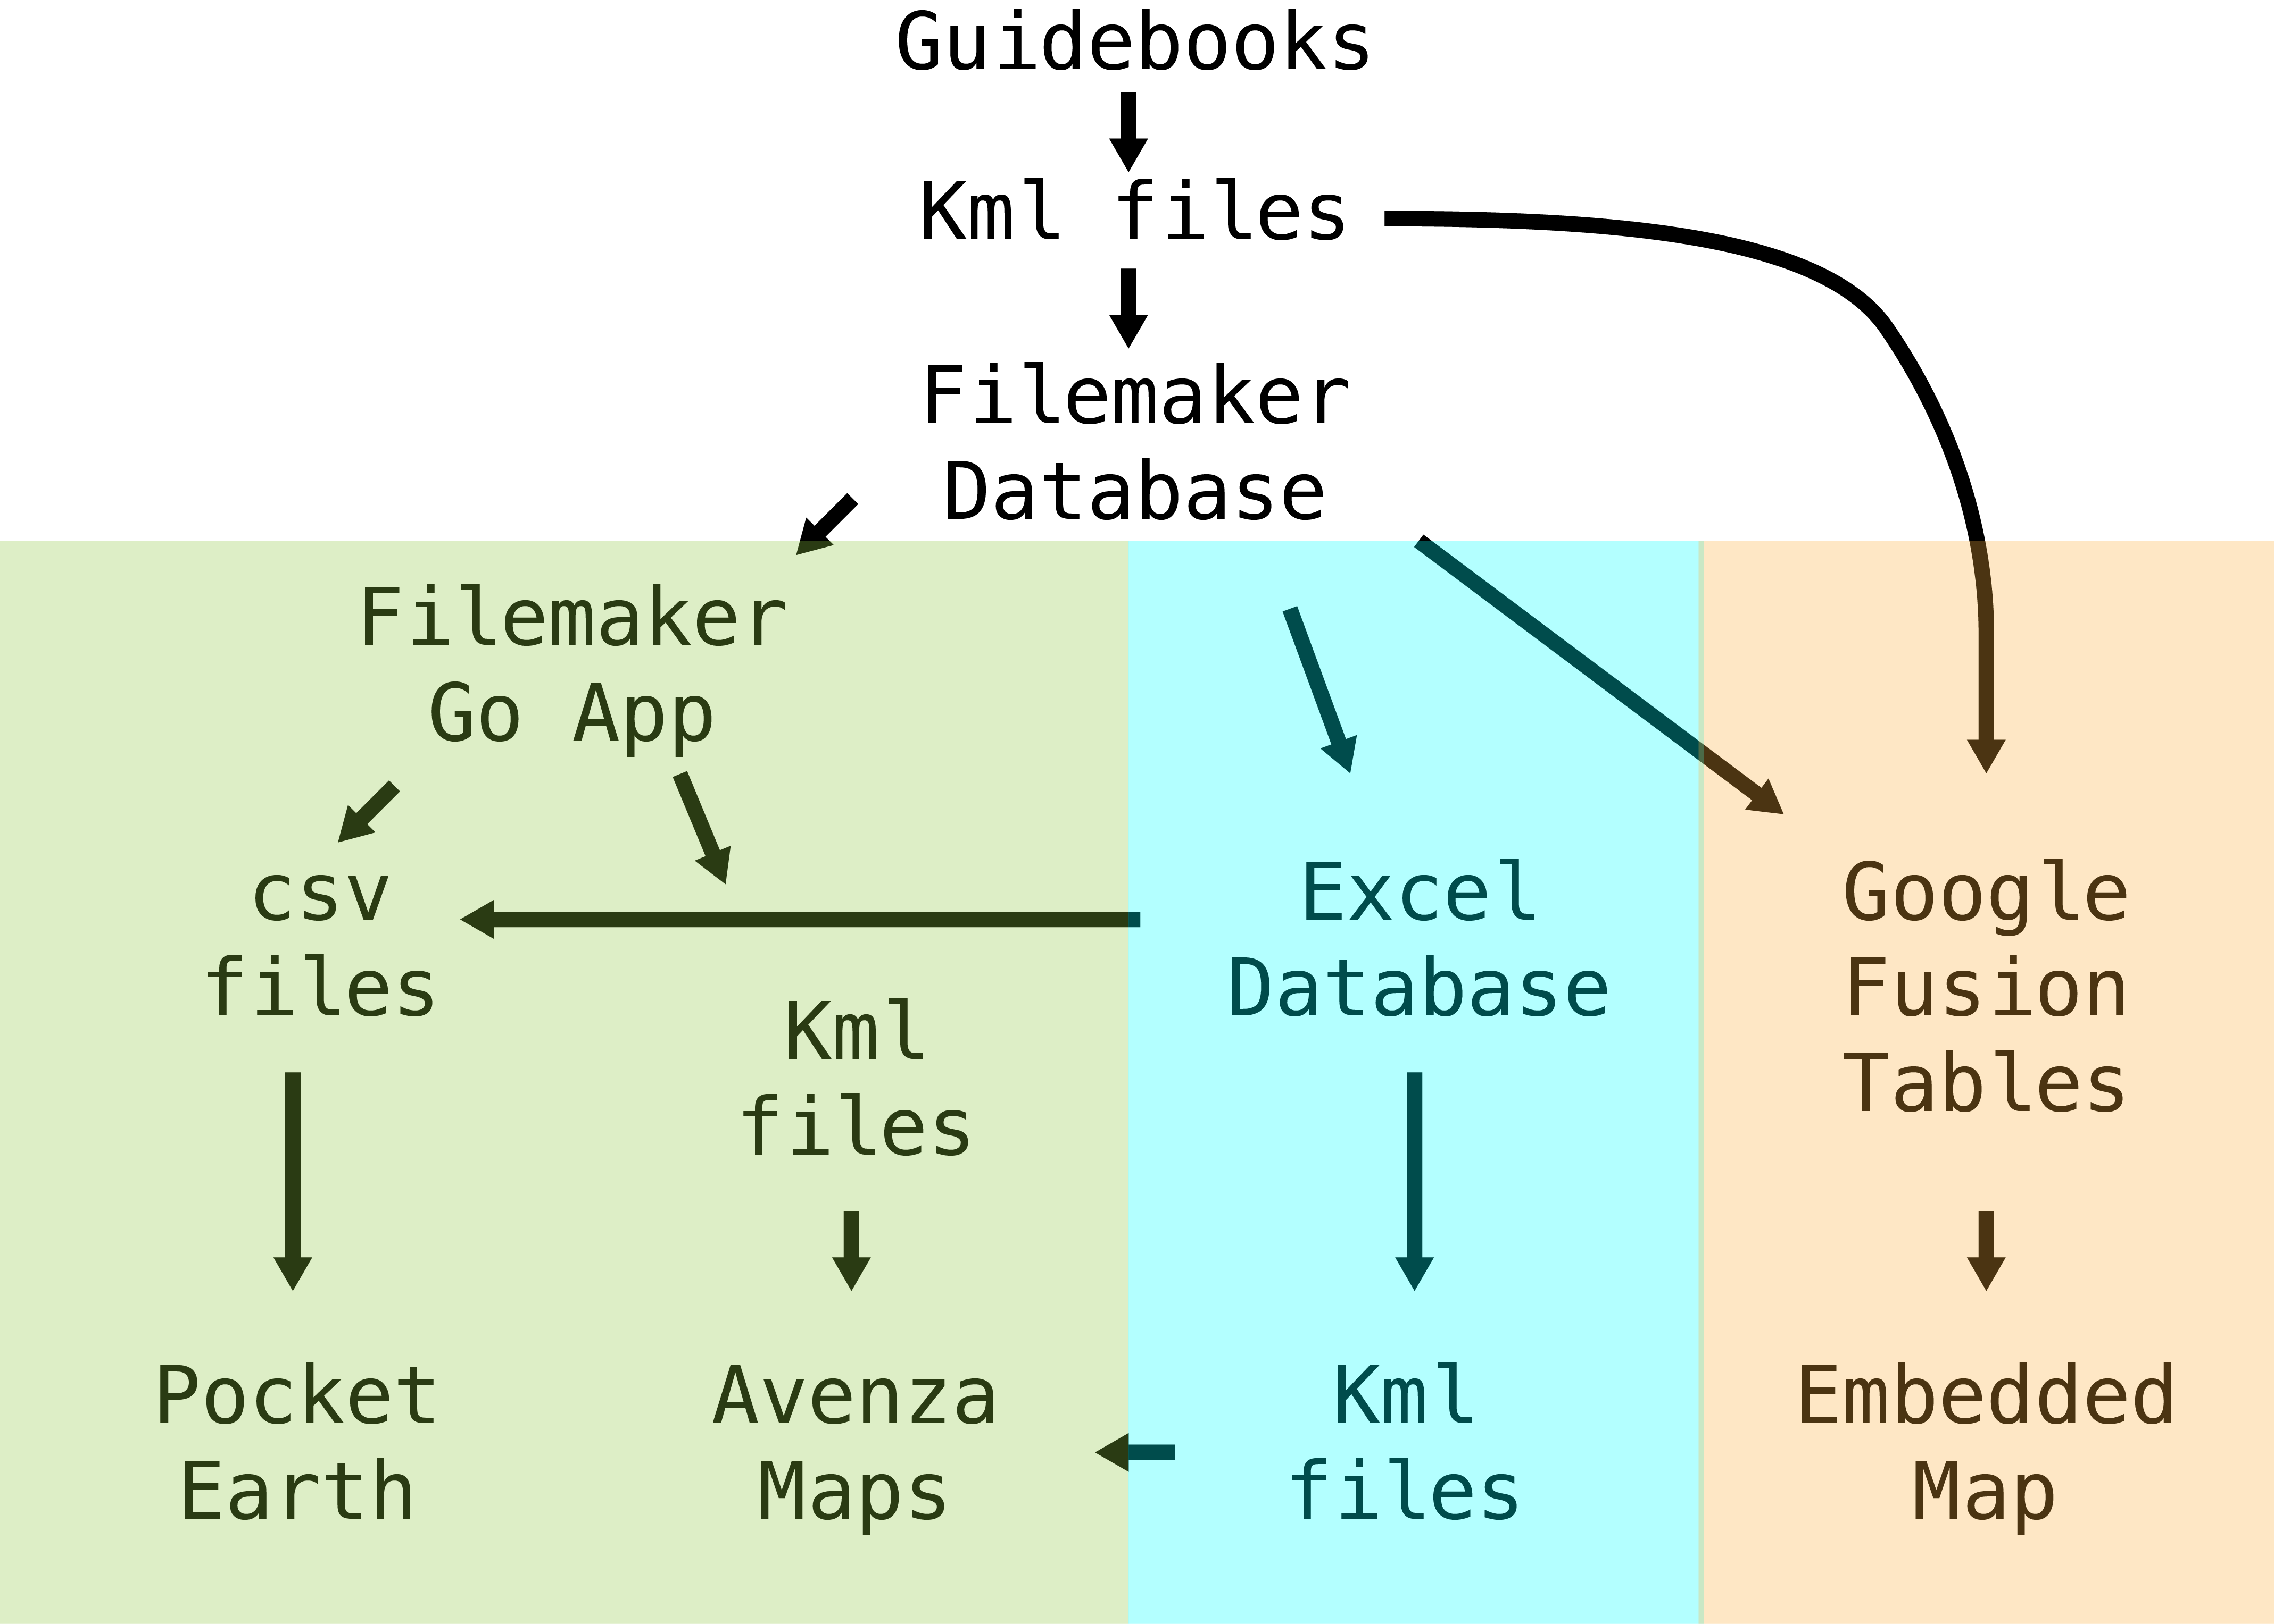
Notes:
Much of our work to date has involved importing the data from the database into portable formats:
iOS or Android
Tablets or phones.
We have reported on these results at past meetings of the GSA and NEGSA. Today, however, we wish to concentrate on the desktop version of Excel which includes tables with very useful filtering capabilities. We begin by admitting that we have produced too much of a good thing...

Slide 7
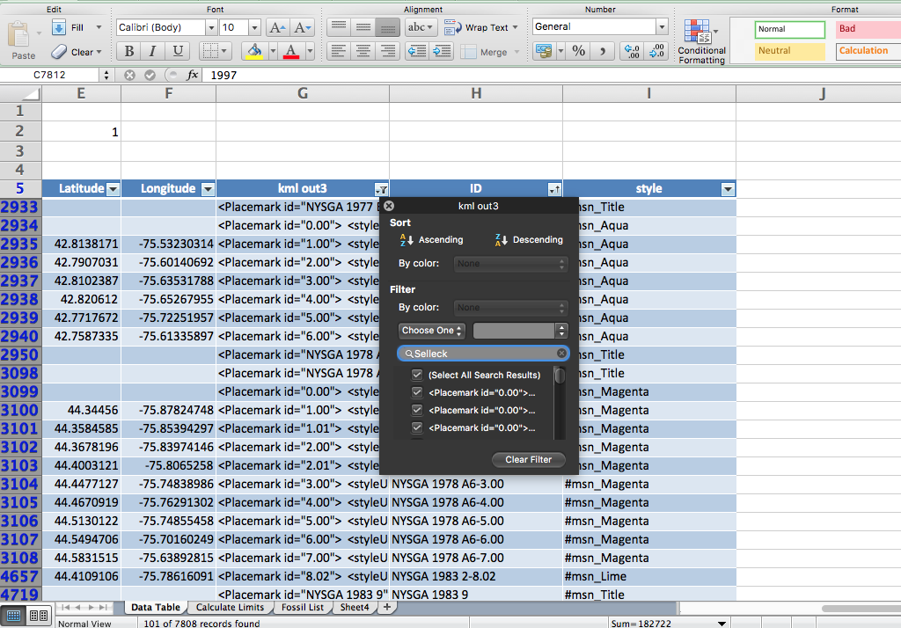
Selleck 101
esker 88
phlogopite 42
<i> 437
f<sub> 85

Slide 8
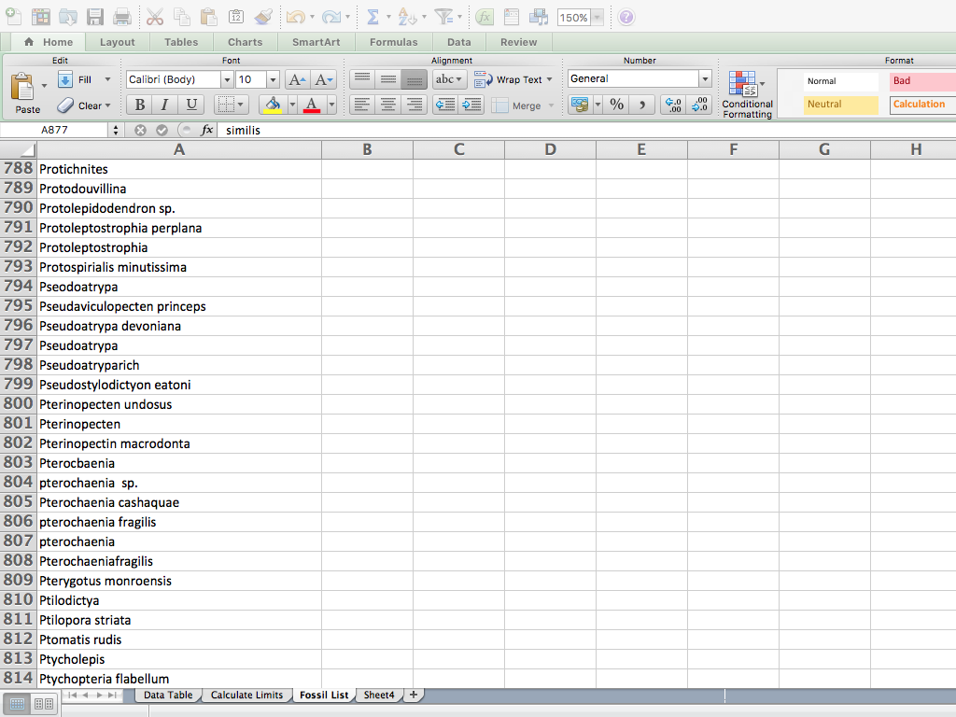
437 stops contain italicized fossil names.
There are 1,037 unique names on this list.
The spelling on this list corresponds to the spelling in the database.
(The Filemaker Database has an index, Excel does not.)

Slide 9
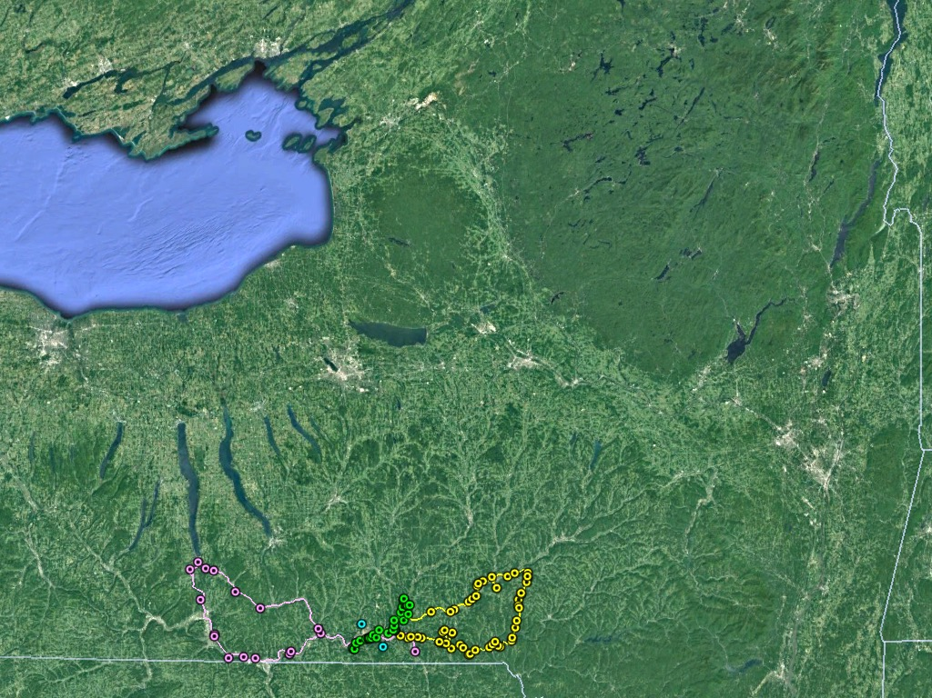
1963
Notes:
Years ago meetings were pretty local. So a map of the field trips would indicate where the meeting was held.
Often the order of the stops is important, as the leader may want folks to see simple examples before more complex ones, or the leader may wish to visit stops in stratigraphic order. So we include the paths taken.

Slide 10
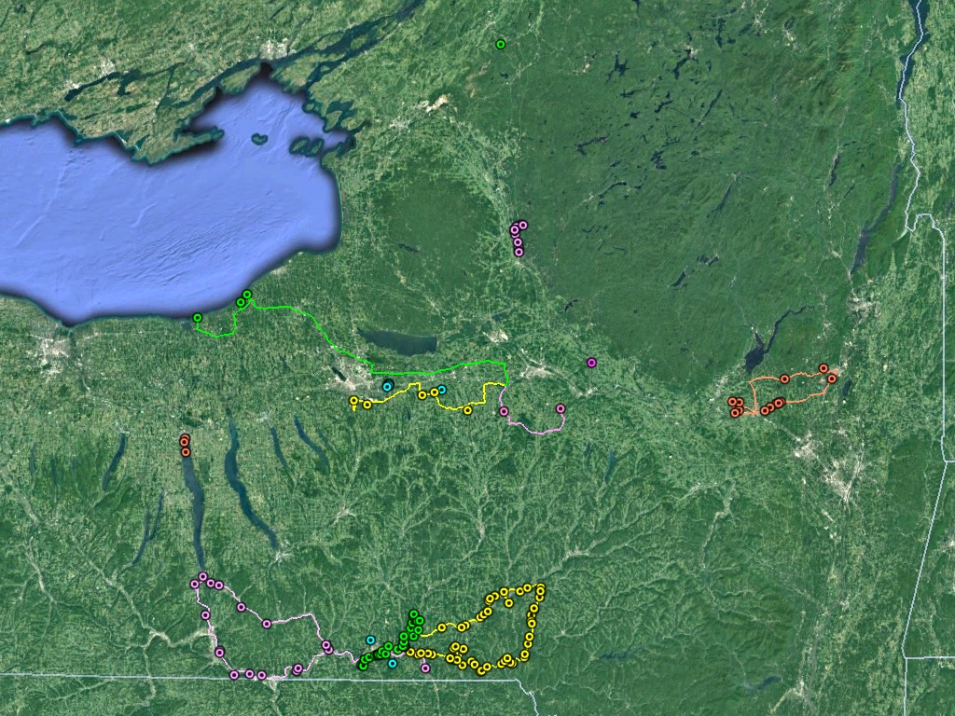
1963 + 1997
Notes:
As transportation got easier the trips spread out. By 1997 it is hard to guess where the meeting was: Was it Syracuse, Saratoga Springs, Utica? There is even a trip to the Lead and Zinc mines in St. Lawrence county! (The meeting was held in Clinton, NY, at Hamilton College.)
This makes browsing through a lot of Guidebooks much more difficult.

Slide 11
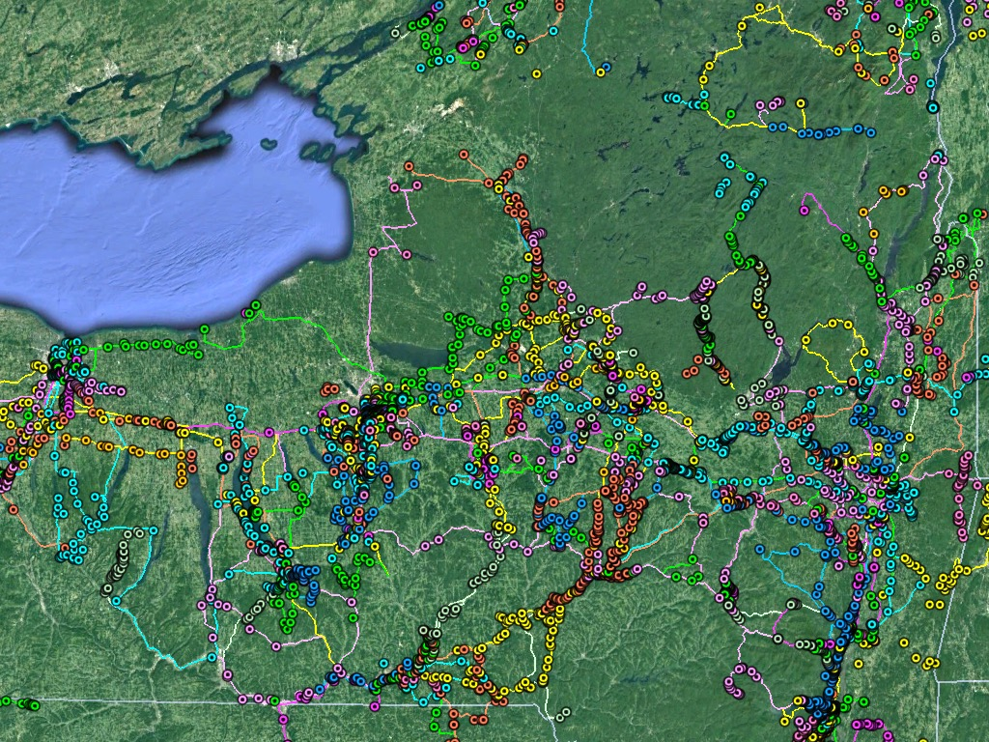
1956 ➤ 1997
Notes:
As the data accumulated things got a little out of hand. We now have over 7000 stops and views. Far too many for most educational purposes.

Slide 12
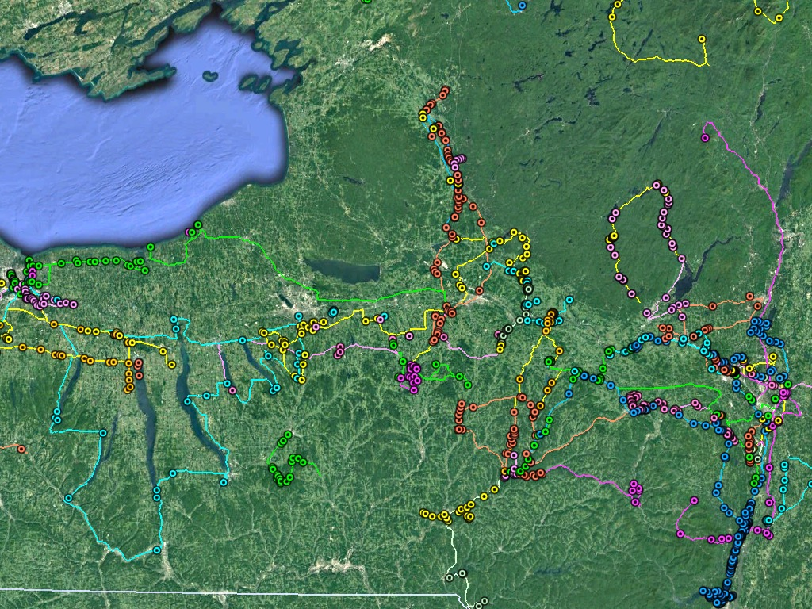
1988 ➤ 1997
Notes:
We could just limit our map to the last ten years' worth of data, and that helps, but it isn't really what we need. And for many educational purposes, the older field trips are very important.

Slide 13
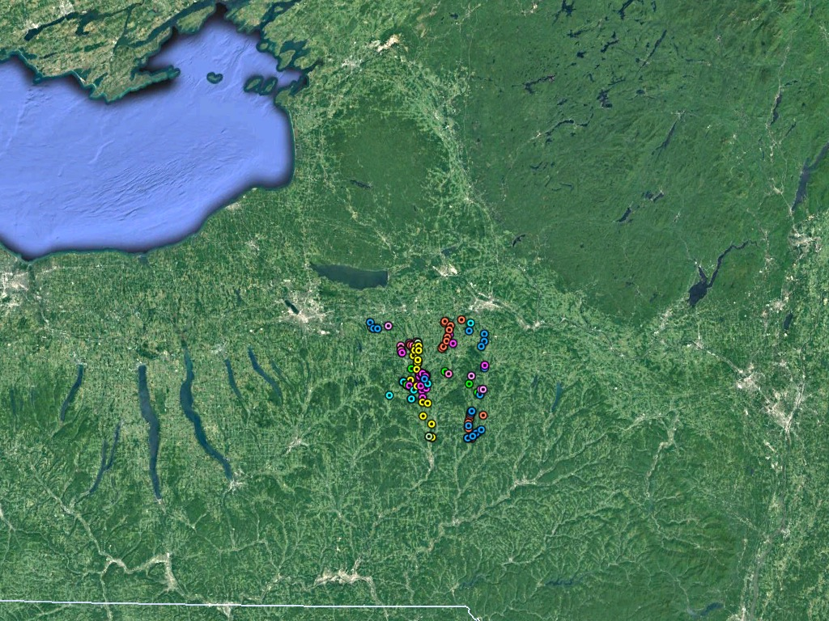
Notes:
Here we see 127 Stops and Views within a 30 mile square, centered on Colgate University, in Hamilton. We wish to let users limit their results spatially, like this. And will use Excel to do it.

Slide 14
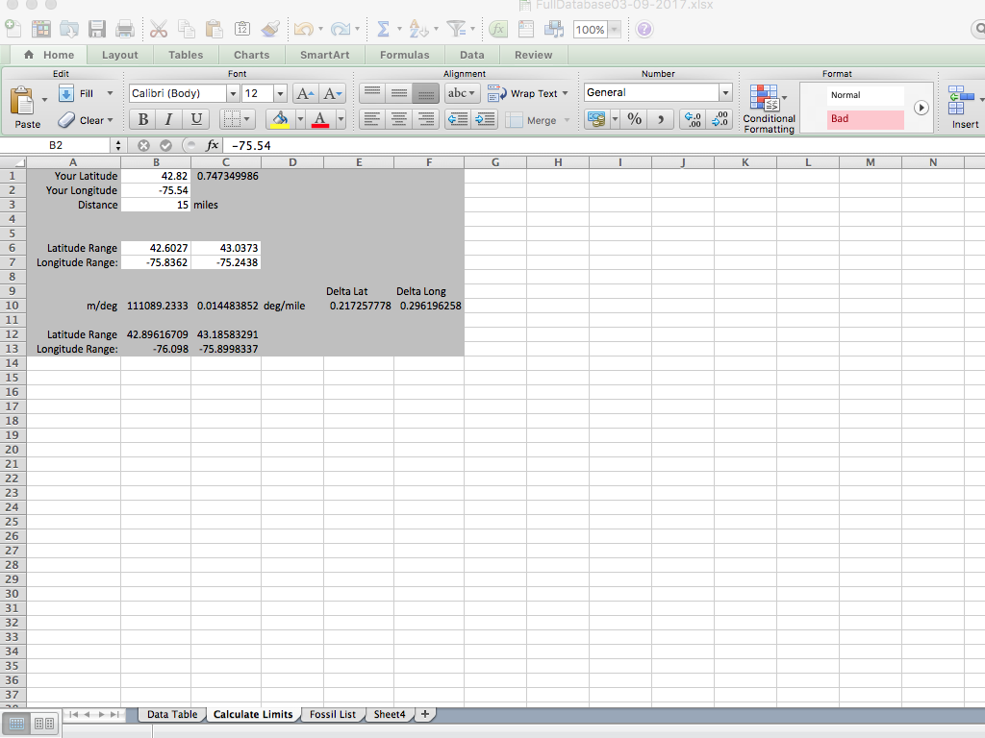
Notes:
The Excel workbook available online, has all of our data in a table, plus a few other sheets. On this page a user can enter a location for the center of a square, and the half-width of the square, here 15 miles. The lat/long boundaries for our square are then calculated, and show up here, and also on the Data Table sheet.

Slide 15
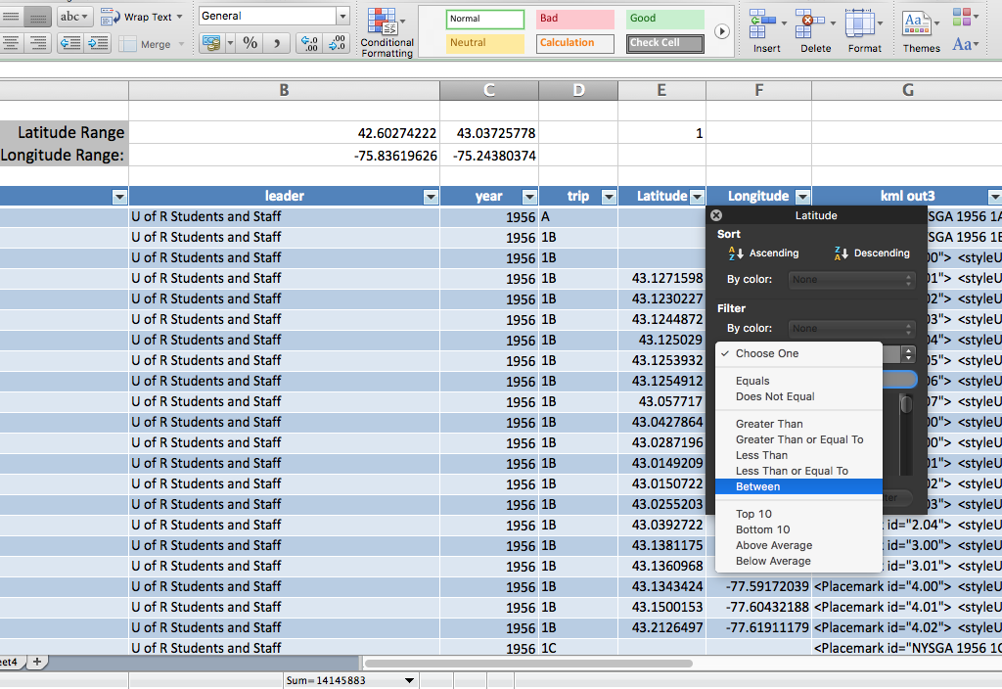

Slide 16
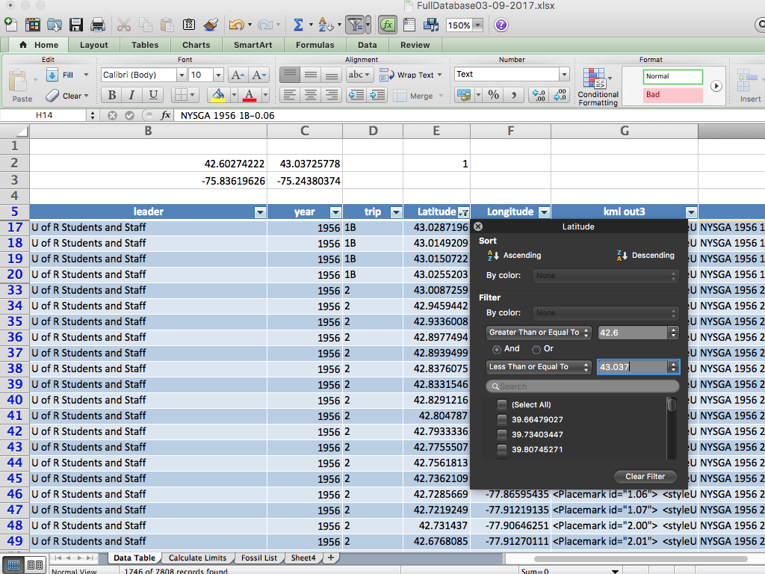
Notes:
So here is the Data Table.
Clicking the dropdown arrow on a title row of a table opens up a filter panel.
First we clicked on this Latitude filter and selected "Between."
Now we can type in the limits for the latitude. This results in culling our 7800 data points down to 1746.

Slide 17
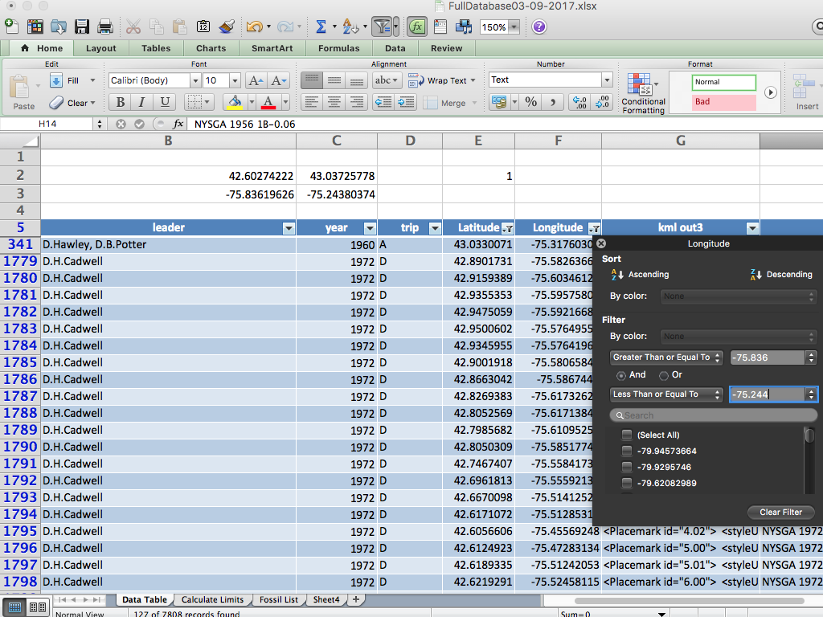
Notes:
Putting in our limits for longitude results in 127 data points. At this point we could:
Copy and paste them into a Word template,
Save the result as a text file with a meaningful name.
Change the extension from .txt to .kml
Open this file in Google Earth with the results shown earlier.

Slide 18
Notes:
Here are the results. A single field trip will have a single color for its placemarks, but more than one field trip may use the same color.
As no entire fieldtrip lies within our boundaries, we don't see any paths.
Had we just selected a trip, we would have ended up with the path and all of its stops.

Slide 19
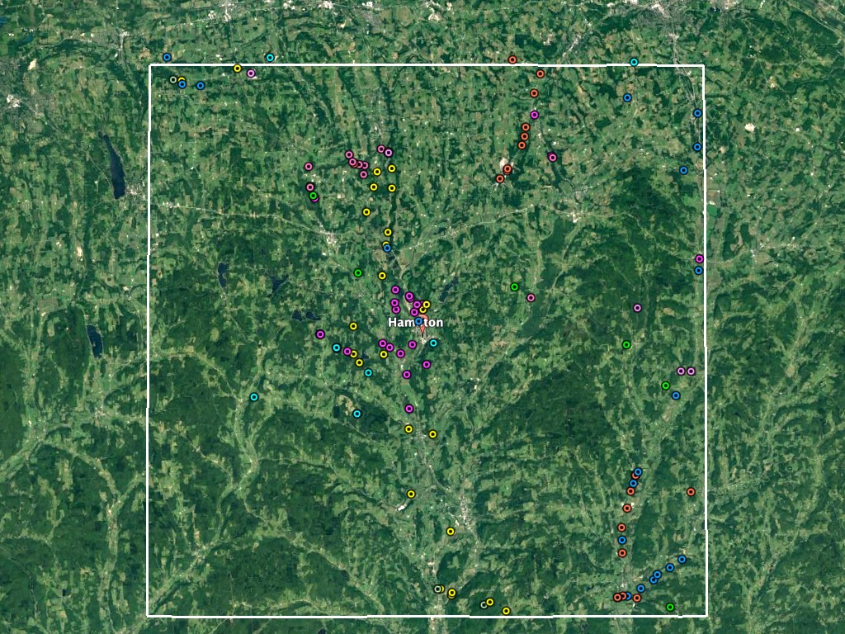
Notes:
Here are those placemarks with a square, 30 miles across, centered on Colgate. 127 is a manageable number of outcrops and field trips.
A teacher at Colgate might take a class to visit any of these points and return the same afternoon.
However, there is a great deal of information contained in the Guidebooks which does not appear in our kml files. All of the Guidebooks from 1956 to 2012 are available on the web

Slide 20
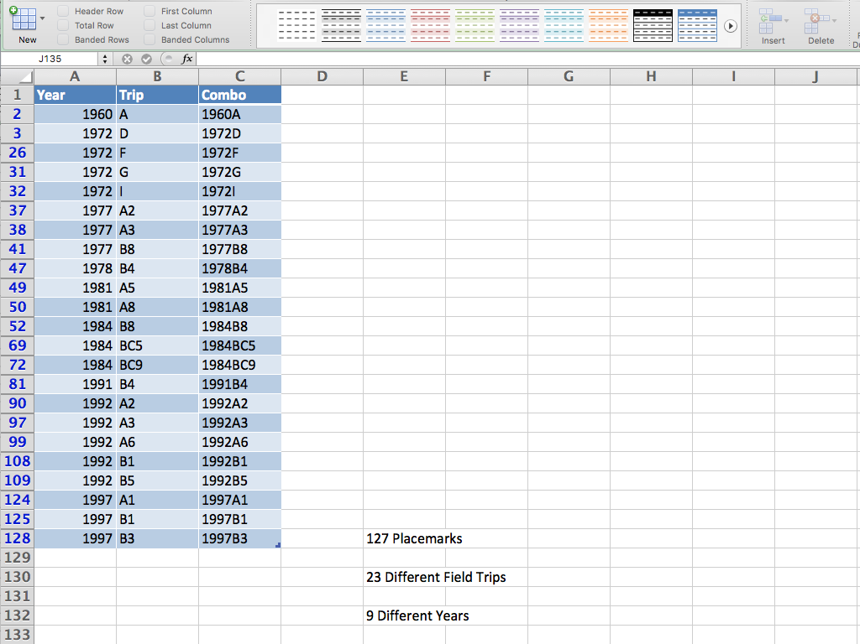
Notes:
Next:
1.Take results from two columns and open them in another spreadsheet
2. Concatenate the two columns
3. Filter that column for unique values
This yields 23 trips within this box.
That a lot are from 1992 isn't surprising, as the meeting was held at Colgate that year. We can check out the others, though. Until now, you would have had to download the pdf of the entire Guidebook, but now we provide you with access to individual chapters from the Guidebooks, and the associated kml file to go with it.

Slide 21
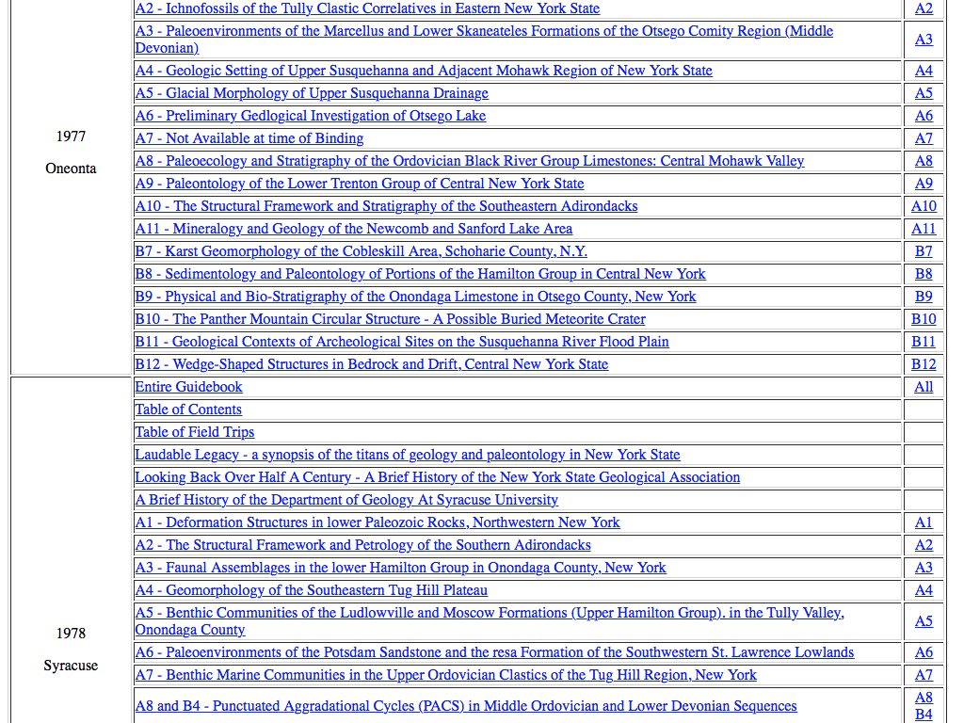
Notes:
This shot from the web page listing most of the chapters from 1977 and 1978 shows those trips we identified earlier.
Downloading the relevant chapters will give you greater insight and context for the trips.

Slide 22
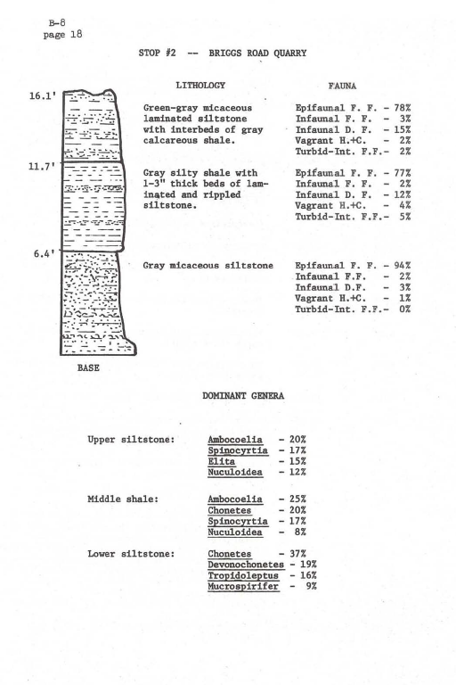
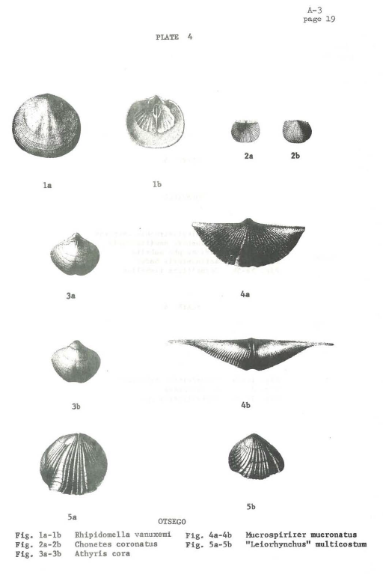
Notes:
Here are pages from two of those trips showing some of the other information provided in the Guidebooks.
These pdf files can be combined into customized field trip guides.

Slide 23
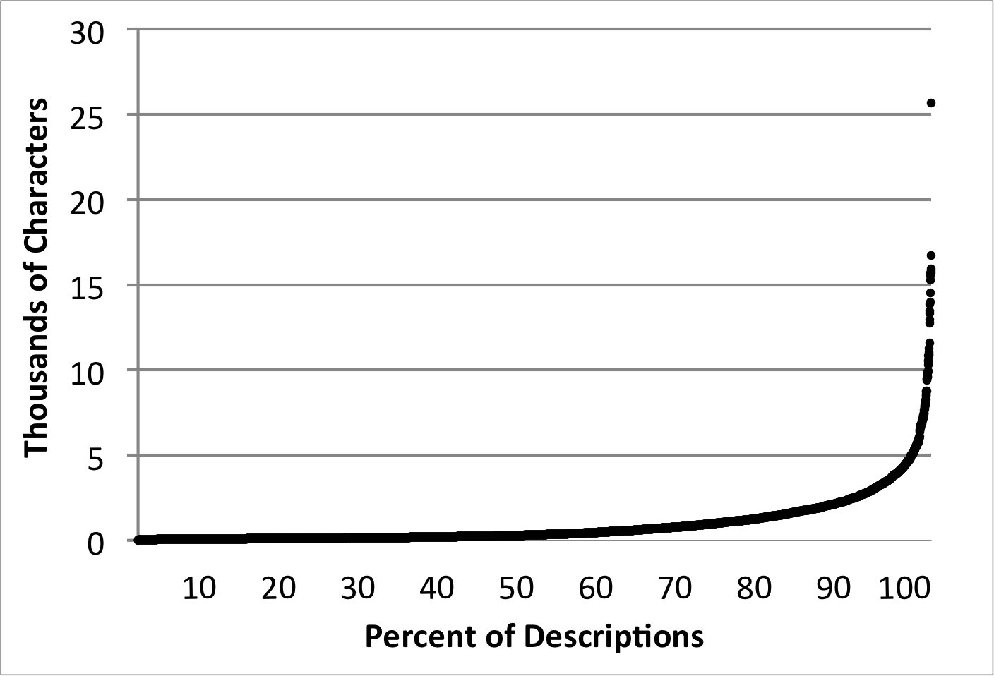
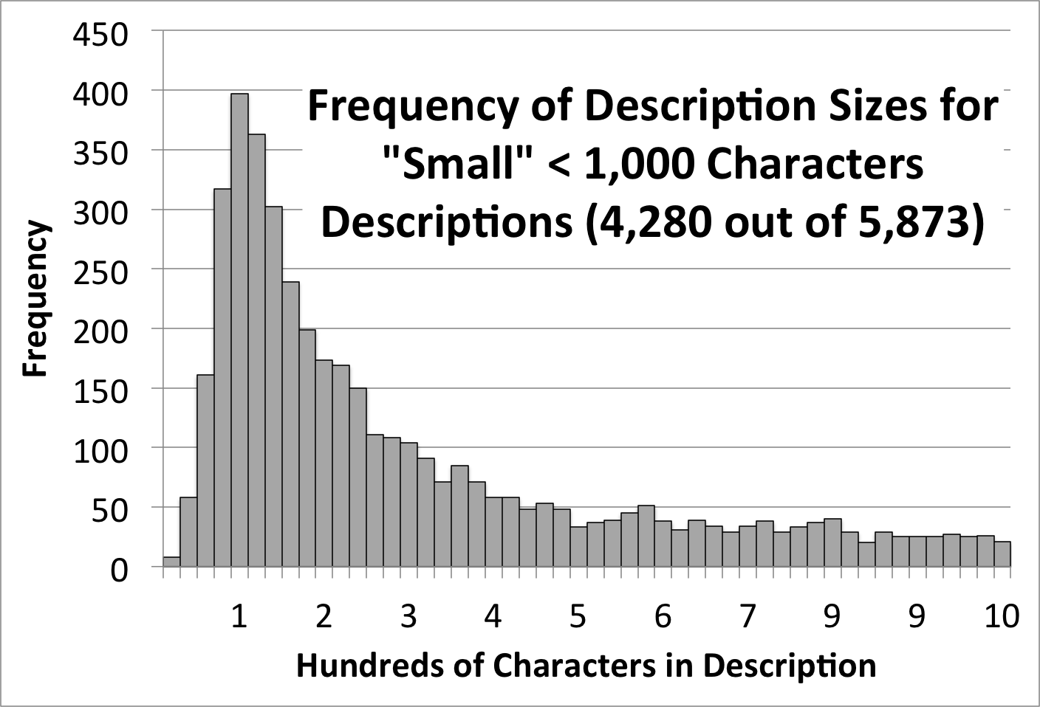
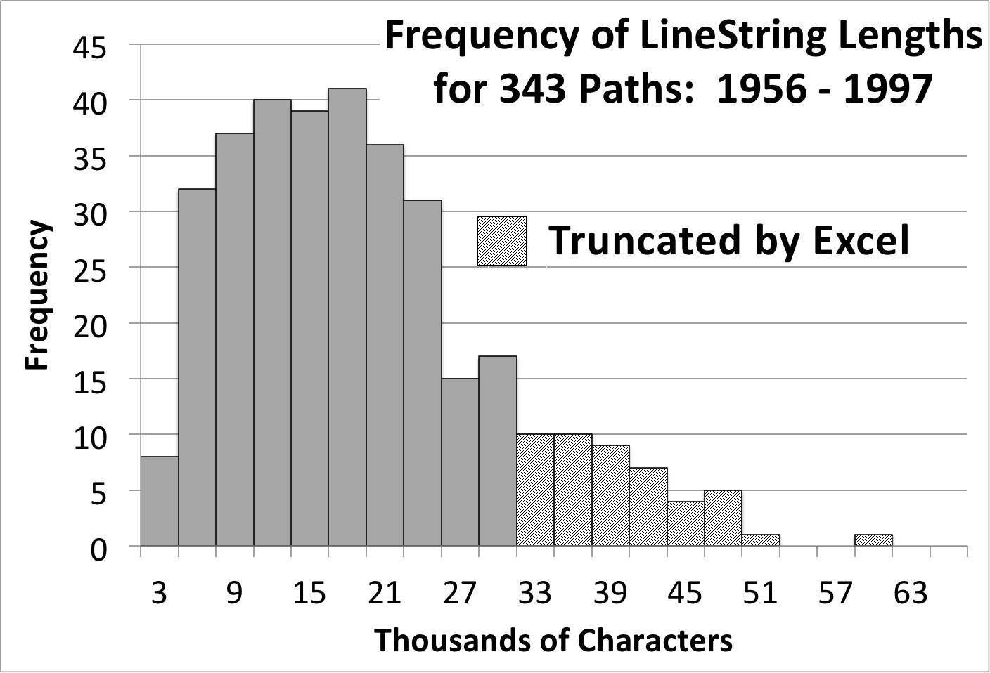
7 years of work, so far:
44 Guidebooks
478 Trips
7,456 Placemarks
2,712 Stops
4,744 Views
(168,617 lines of code and text)
Notes:
This application of Excel to our database has two disadvantages:
The Excel available for tablets and phones does not play well with tables. The functionality we used is available only on the desktop version.
The maximum size for data in an Excel cell is 32,767 characters.
As you can see, the longest description we have encountered so far is 26,000 characters, so descriptions are copied in full.
However the LineStrings which record all of the lat/long pairs for the paths can be much lengthier, in which case they are truncated by Excel.

Slide 24
Files for years:
http://ottohmuller.com/nysga2ge/Files.html
Guidebook Chapters from 1956-1997:
http://ottohmuller.com/nysga2ge/Trips1956-1997.html
Guidebook Chapters from 1998-Onward
http://ottohmuller.com/nysga2ge/Trips1998-Onward.html
Excel Database and support files:
http://ottohmuller.com/nysga2ge/ExcelDatabase.html
Special thanks to Alexander Bartholomew of SUNY, New
Paltz, for scanning many of the Guidebooks!

